Slide 1
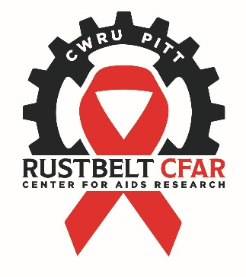
Rustbelt Center for AIDS Research
Case Western Reserve University/University Hospitals Cleveland Medical Center
University of Pittsburgh

